Slide 1
Maths workshop
Problem Solving
8th March 2017
Thank you for coming

Slide 2
Aim of the session today….
Share the expectations related to the new curriculum
Discuss the progression in problem solving from KS1- KS2
Share with you some useful strategies to help
To have your questions answered

Slide 3
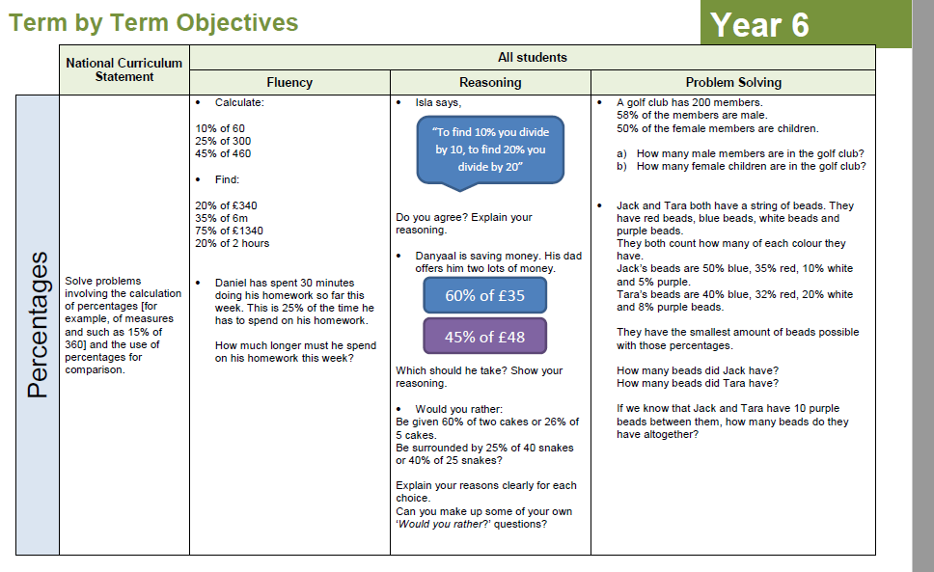

Slide 4
Progression in problem solving
Year 1: Solve one-step problems that involve addition and subtraction, using concrete objects and pictorial representations, and missing number problems such as:
7 = __ - 9
Year 3: solve problems, including missing number problems, using number facts, place value, and more complex addition and subtraction.
e.g.
__ – 105 = 93
Year 6: Solve addition and subtraction multi-step problems in context, deciding which operations and methods to use and why?
Becky says:
I bought 20 apples. They were 45p each, but the shopkeeper let me have £1.50 off because I was buying so many.
Kieran says:
I bought 20 apples. They were 50p each, but the shopkeeper gave me a 10% discount because I was buying so many.
Who has the best deal?

Slide 5
Useful strategies:
Working backwards
Trial and improvement
RUCSAC

Slide 6
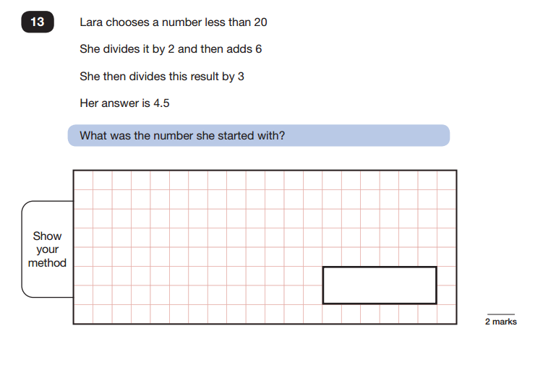
Working backwards
Starting from the end might sound counterintuitive, but it can be an efficient way of solving a problem.

Slide 7
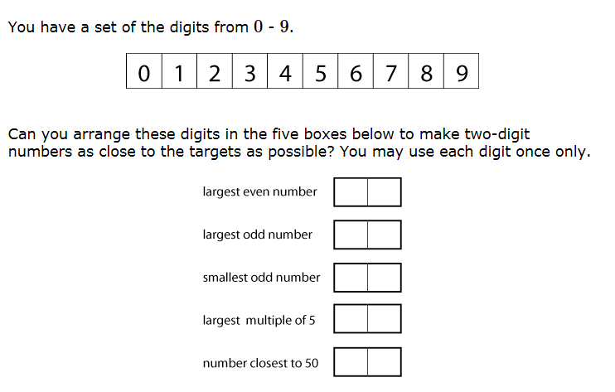
Trial and improvement:
Trial and improvement involves trying something out, which will always give more insight into the context and therefore gives the solver a better idea of what to try next. Trial and improvement is often the start of working systematically.

Slide 8
Worded problems and solving them
A word problem is a few sentences describing a 'real-life' scenario where a problem needs to be solved by way of a mathematical calculation.
Word or story problems are seen as a crucial part of learning in the primary curriculum, because they require children to apply their knowledge of various different concepts to 'real-life' scenarios. This is why teachers try to include word problems in their maths lessons as often as possible.
Word problems also help children to familiarise themselves with mathematical language and terms such as: fewer, altogether, difference, more, share, multiply, subtract, equal, reduced, etc

Slide 9
KS1 worded problems
Solve one-step worded problems involving all four operations
e.g.
Sarah has 13p. She needs 20p to buy her magazine. How much more does she need to save?

Slide 10
KS2 worded problems
A two-step problem is a word problem that requires two operations to solve it, for example:
I buy a magazine costing 83p and a pencil costing 45p. I pay with a voucher that gives me 20p off the things I am buying. How much do I spend?
•In this case, the first operation would be addition (83p + 45p = £1.28).
•The second operation is subtraction (£1.28 - 20p = £1.08).

Slide 11
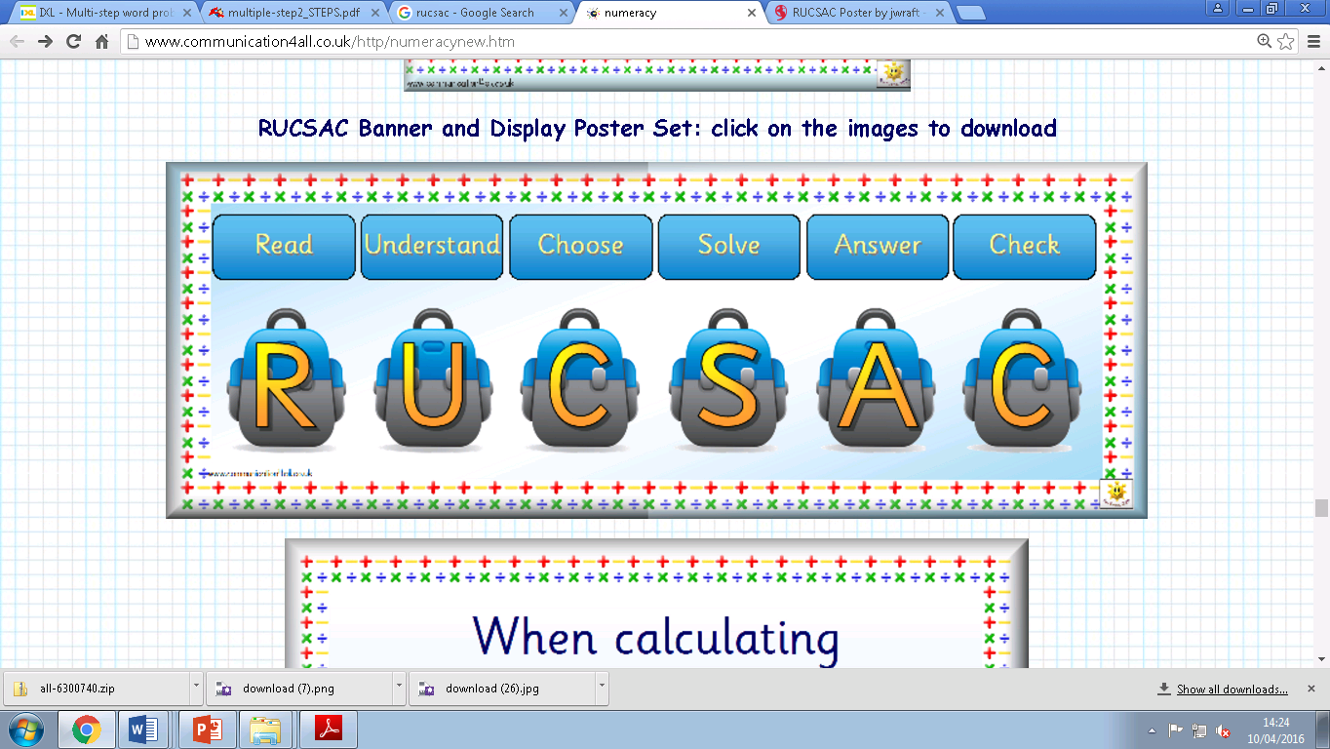
What is RUCSAC?
Is a method that can help support you when answering word problems.
It means …

Slide 12
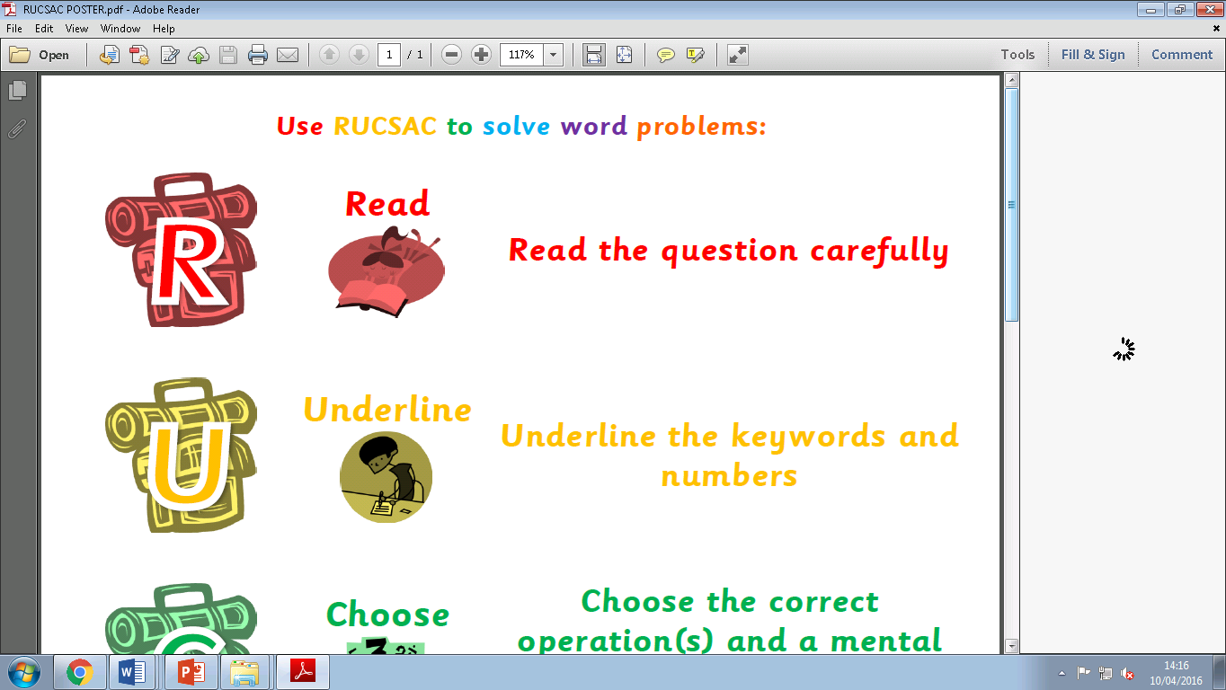

Slide 14
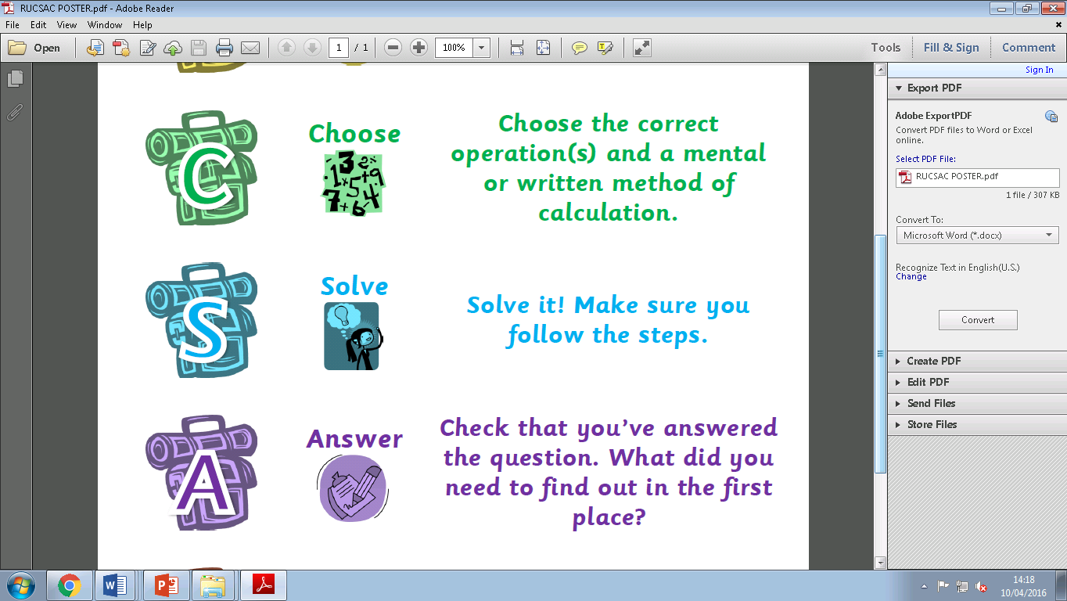

Slide 17
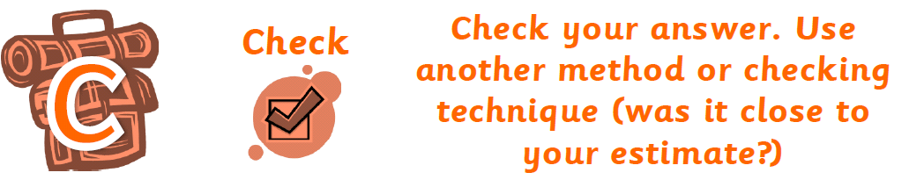

Slide 19
Word problem 1
Ethan bought 5 books about animals, 9 books about outer space, and 3 books about trains. Each book cost £10. How much did Ethan spend on the books?
Money spent on books = _______________
Step 1 – Find the total number of books.
5 + 9 + 3 = 17
Step 2 – Find the cost of the books.
£10 × 17 = £170
Step 3– Answer = £170 spent on books

Slide 20
Word problem 2
There are 62 students in the orchestra and twice that number in the band. There are 38 boys and 13 girls in the choir. If each student only participates in one group, how many students in total are there in the orchestra, the band, and the choir?
.
​_______ students
Step 1 – Find the number of students in the band.
2 x 62 = 124
Step 2 – Find the number of students in the choir.
38 + 13 = 51
Step 3 – Find the total number of students.
124 + 62 + 51 = 237
Step 4– Answer = 237 students

Slide 21
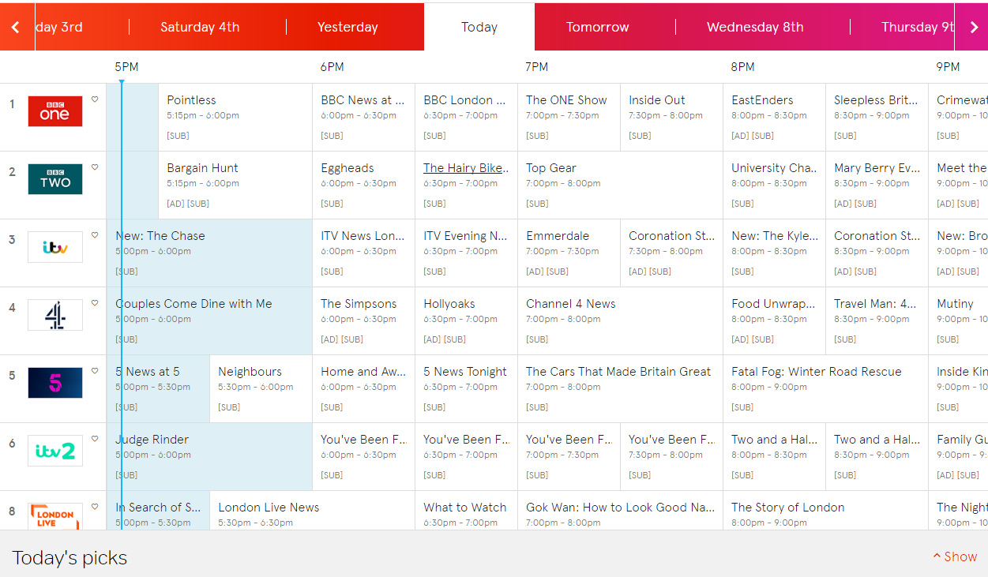
Ideas you can use at home…what do you do currently?
Shopping: ask children to total a number of items for you; ask them to help calculate the change you should receive.
TV guides: ask children to calculate how long a programme will last for, or how many minutes till their favourite programme is due to begin.

Slide 22
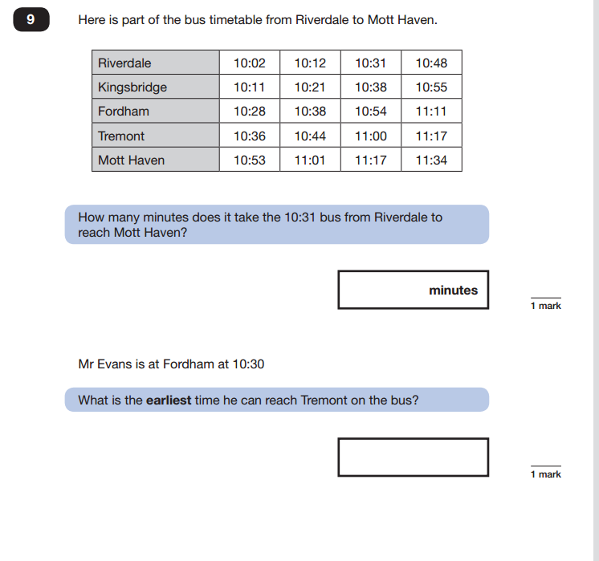
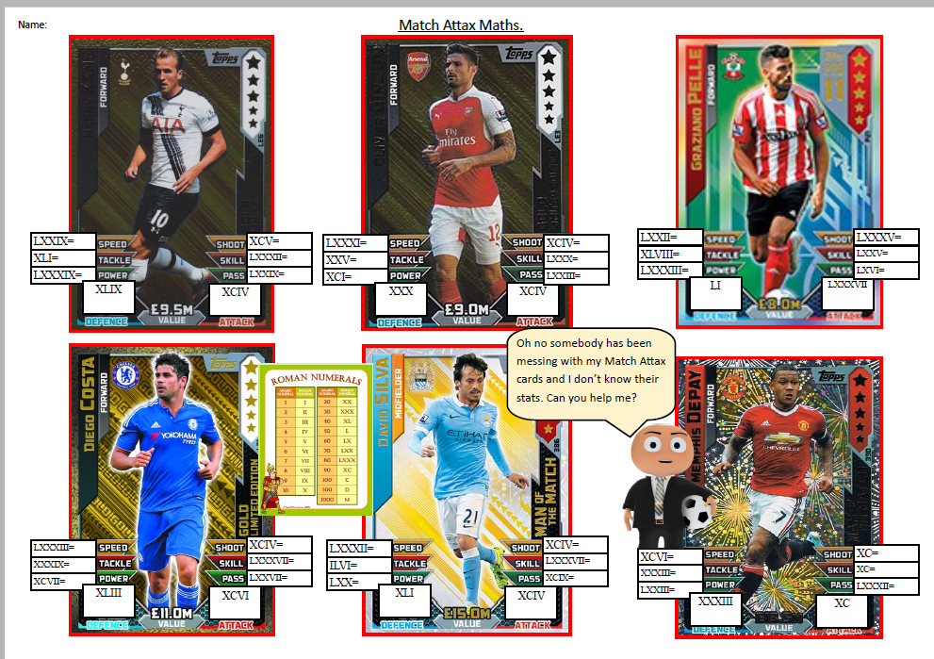
Timetables: if using public transport then ask children questions regarding the journey you
are about to embark on.
Match Attax cards:
Board games e.g. snakes and ladders

Slide 23
In your packs…
Set of digit cards (0-9)
Questioning template
‘RUCSAC explained’ poster
Match Attax maths cards
Topical maths problems to try at home with answers
List of useful websites

Slide 24
Websites that might help…
https://ec1.educationcity.com/
http://www.theschoolrun.com/what-are-two-step-and-multi-step-problems
http://www.primaryresources.co.uk/maths/mathsD1.htm
http://www.teachingideas.co.uk/subjects/problem-solving
https://nrich.maths.org/10334
http://www.topmarks.co.uk/maths-games/7-11-years/problem-solving/
http://www.topmarks.co.uk/maths-games/5-7-years/problem-solving
http://www.primaryhomeworkhelp.co.uk/maths/

Slide 25
Thank you for coming
Please stay and enjoy the refreshments we have available.
If you have any further questions, feel free to talk to one of the maths team.
Thanks again for your support.

